Slide 1
Task Manager App
App Features
A simple Python-Flask based app having CRUD functionalities.
We can add a New Task, add description, set priority, edit our task, delete out task and the task gets removed from table once completed.
Task Gets added in the table in the ascending order of due data
IT is connected to SQLite Data base in the backend
Technologies and languages used
Python
flask
HTML
CSS
Bootstrap

Slide 2
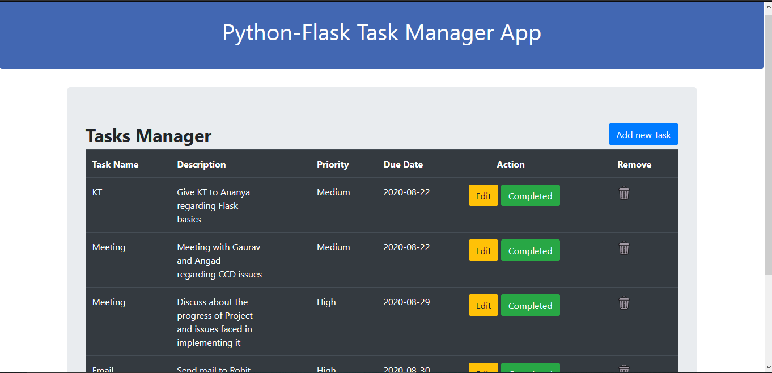

Slide 3
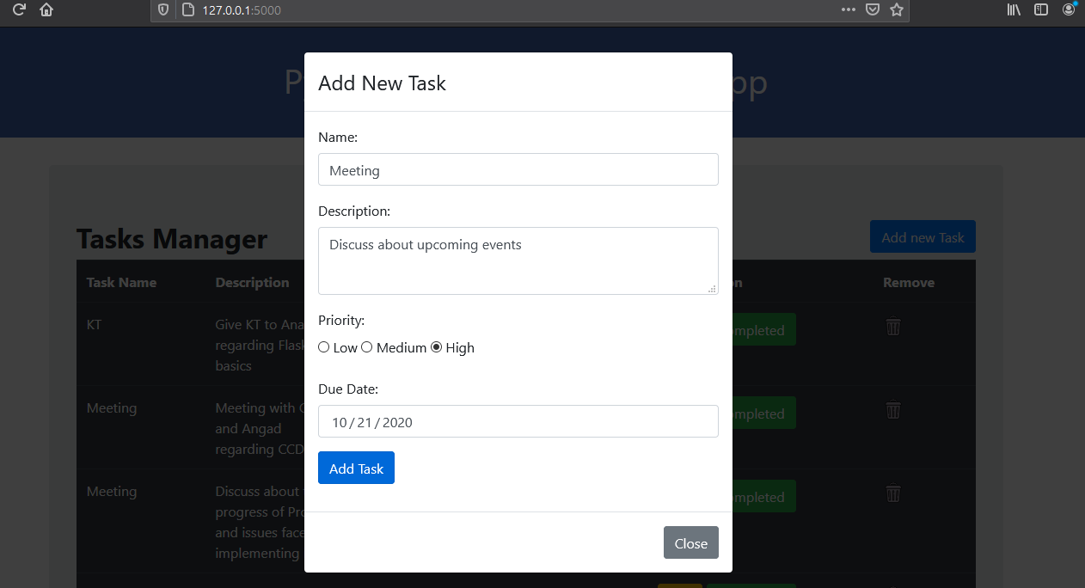
Add New Task

Slide 4
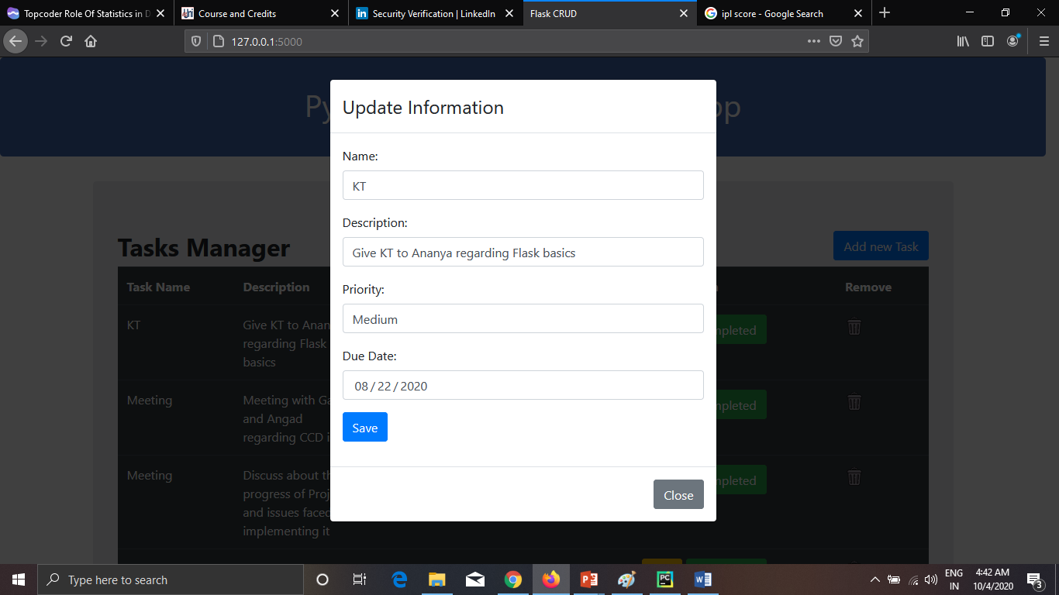
Edit Task

